Slide 1
LAB 8
Eco-System

Slide 2
OBJECTIVES
Learn about the EcoSystem
What is Db4oUtil, how to use it
Learn Enterprise, Organizations and Networks
Learn Roles and Work Request Flow

Slide 3
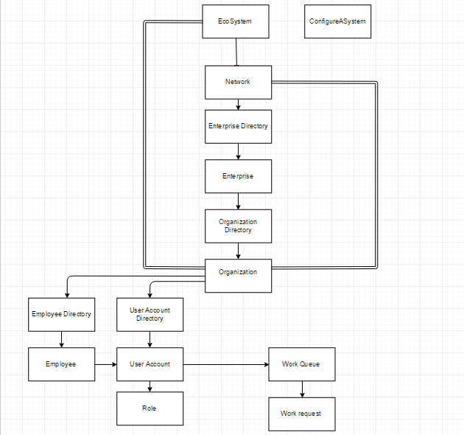
ECO SYSTEM ARCHITECTURE
Extends
(only for code reusability)

Slide 4
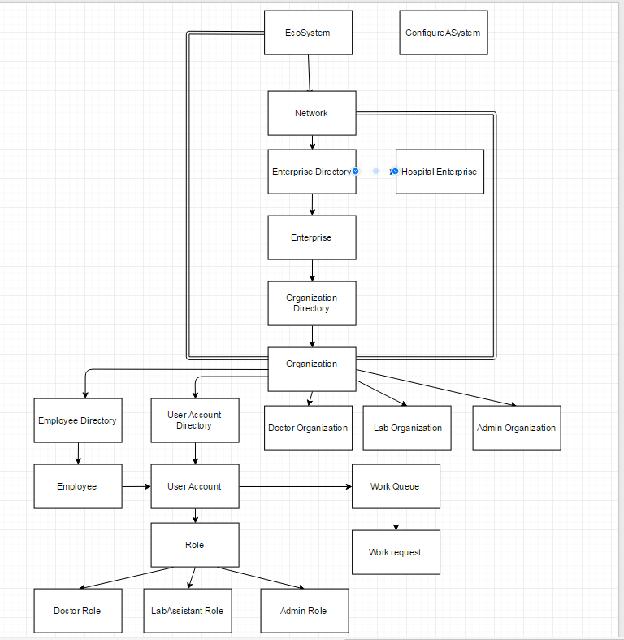
ARCHITECTURE

Slide 5
ROLES AND WORK REQUEST FLOW
System Admin Role
1. System Admin creates a Network
2. System Admin creates an Enterprise under Network
3. System Admin creates enterprise admin and provides username and password
Enterprise Admin Role
1. Admin creates a Lab and Doctor Organization
2. Admin Role adds users of Doctor and Lab.
3. Admin creates doctor and lab employee's
4. Admin Provides username and password for doctor and lab employee's

Slide 6
ROLES AND WORK REQUEST FLOW
Doctor Role
1. Doctor login
2. Doctor request for the test(Initiate work request)
3. Doctor submits the request
Lab Role
1. Lab Assistant Login
2. Lab Assistant processes the request which was submitted by the Doctor
3. Lab Assistant assigns the work request to himself
4. Lab Assistant process the request and submit back the request.

Slide 7
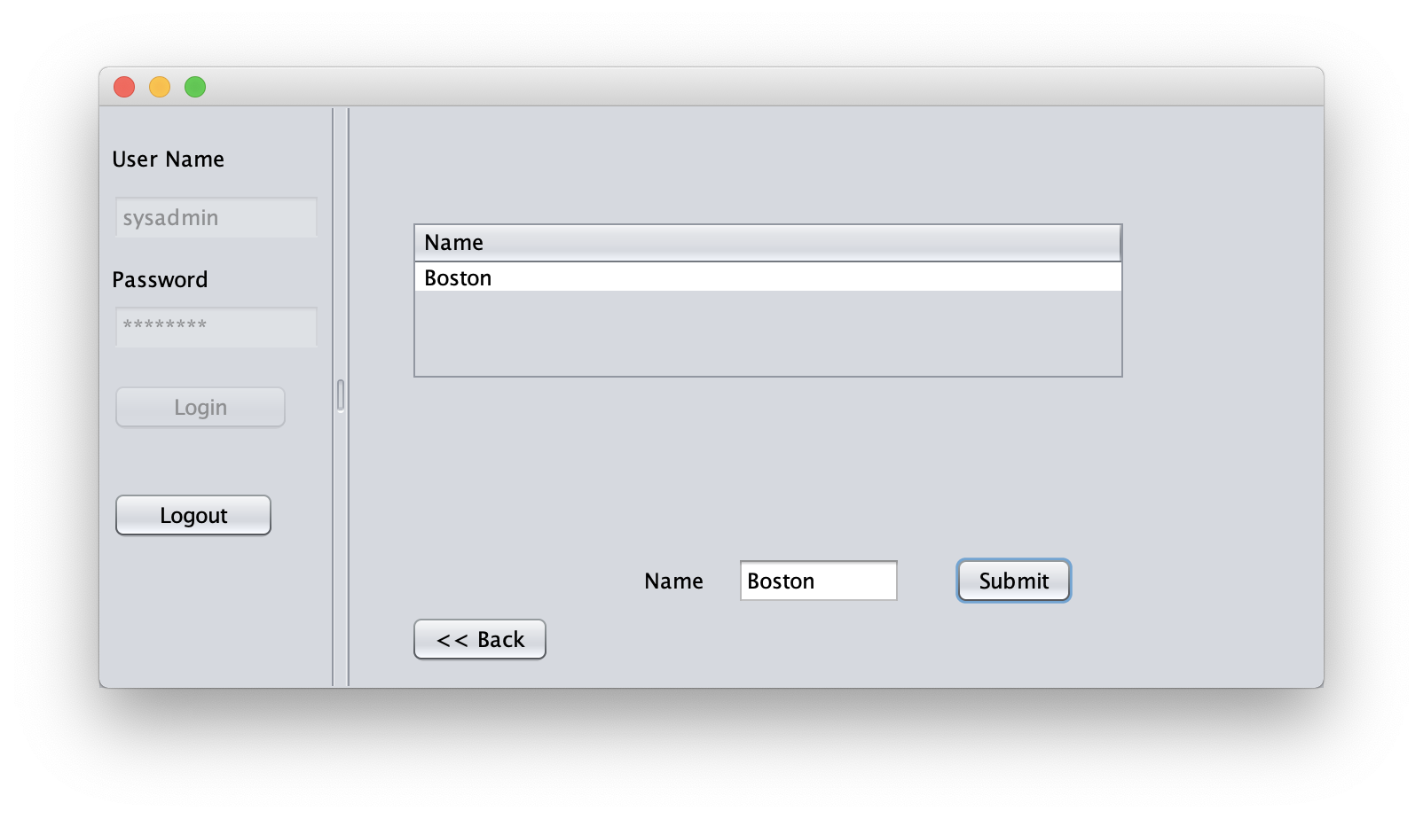
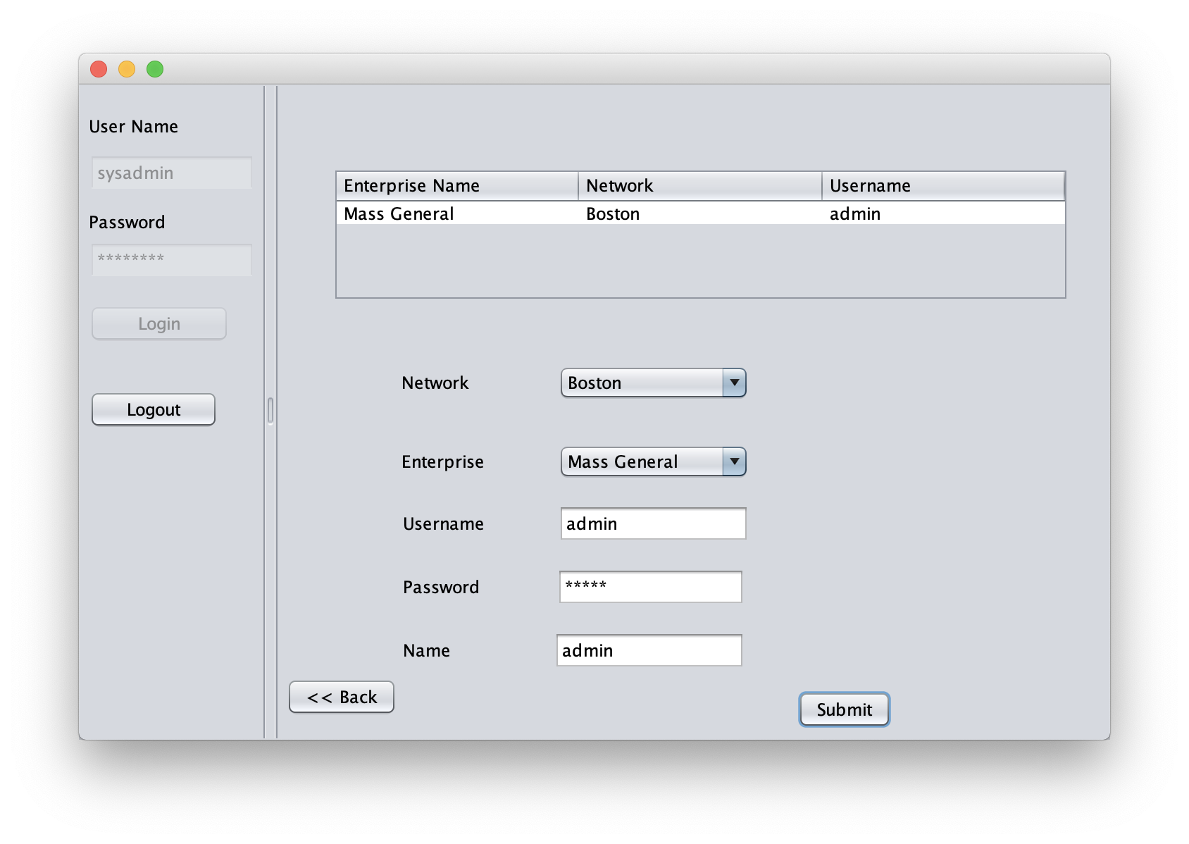
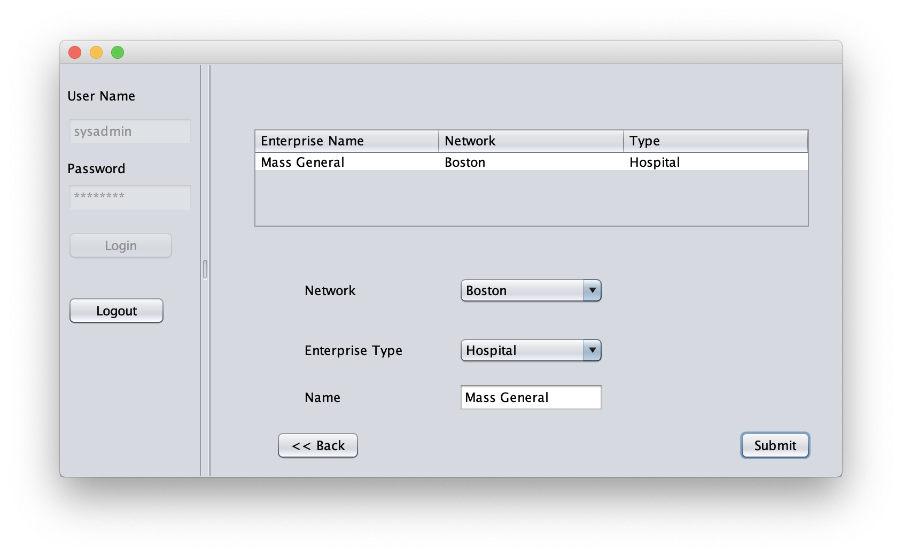
SYSTEM ADMIN
3. Create Enterprise Admin
1. Create Network
2. Create Enterprise

Slide 8
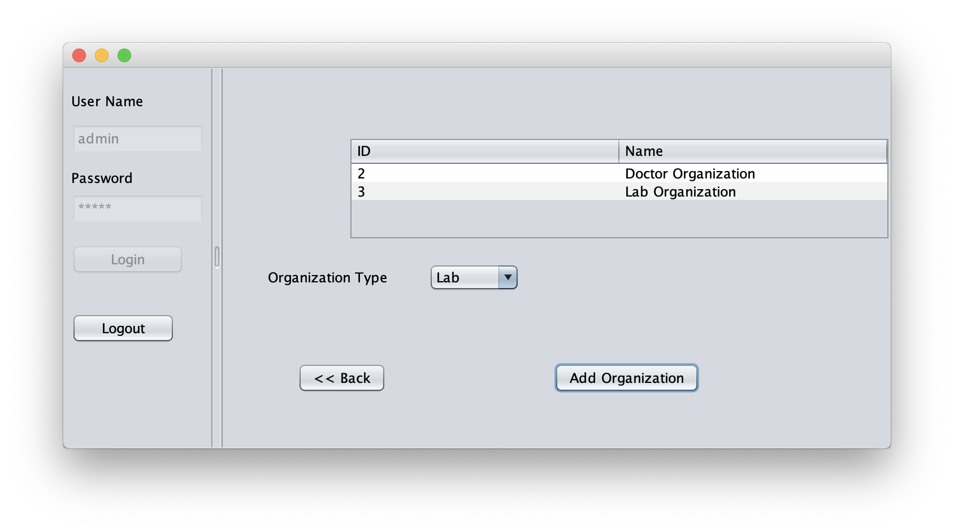
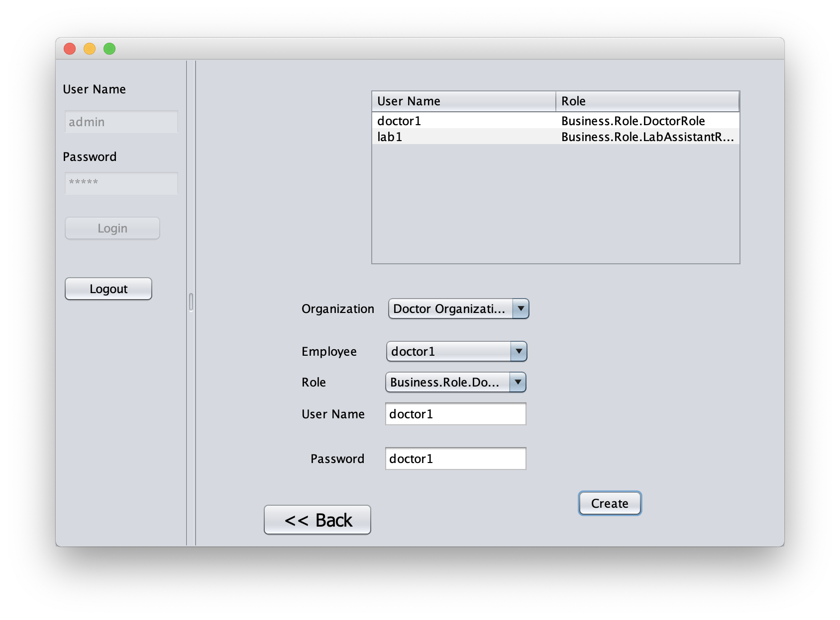
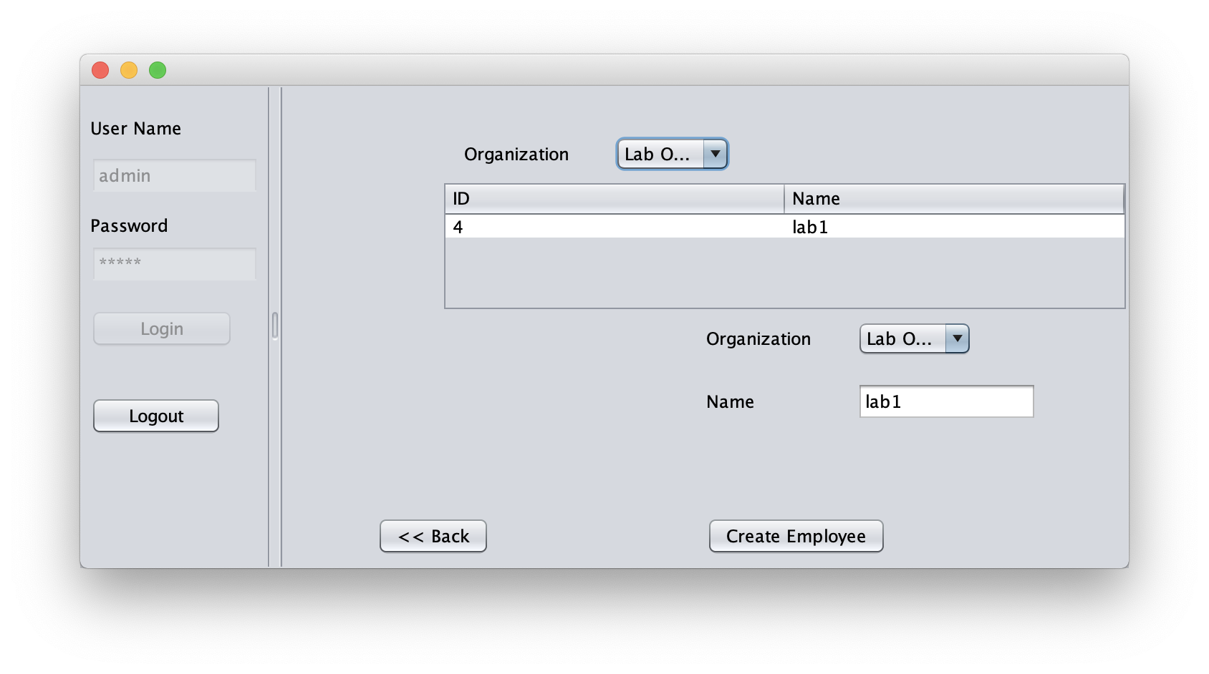
ENTERPRISE
ADMIN
1. Create Organizations
3. Provide username and password
2. Create Employees

Slide 9
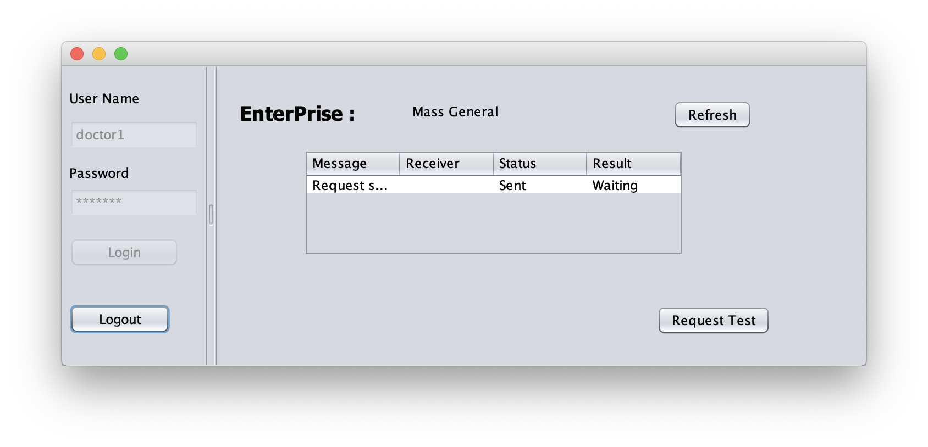
DOCTOR
Send test request and wait for lab assistant

Slide 10
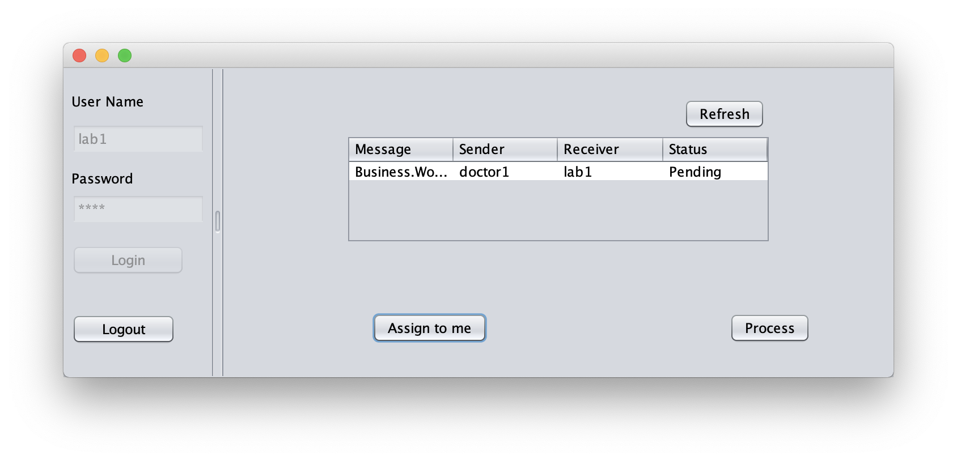
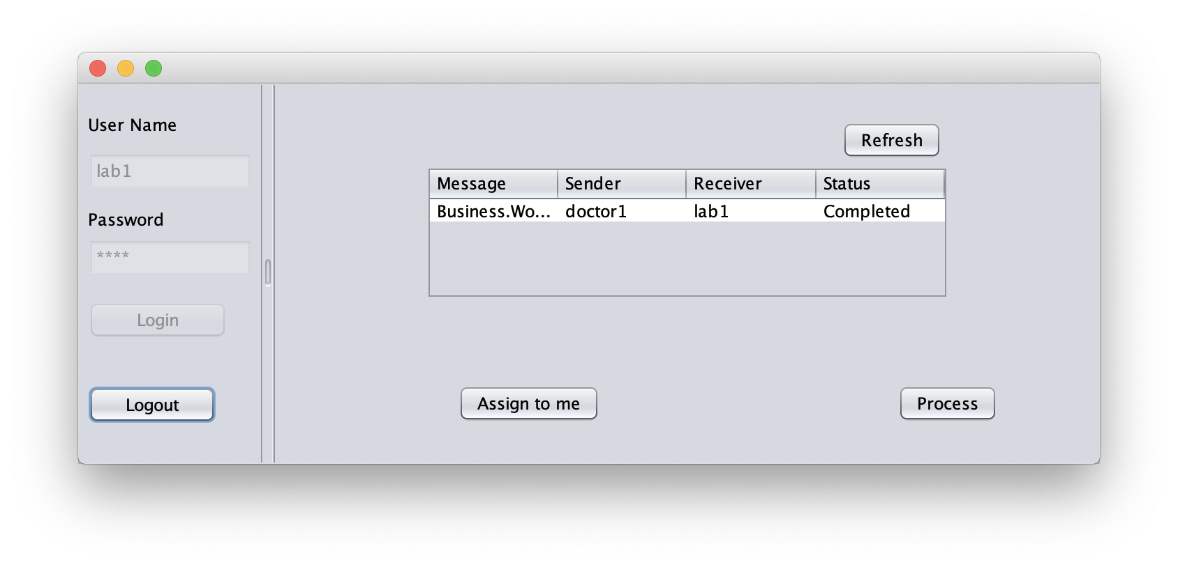
LAB ASSISTANT
Assign request to itself
Finish the test and send result back to doctor

Slide 11
DB4O
db4o (database for objects) was an embeddable open source object database.
Main goal:
provide an easy and native interface to persistence for object oriented programming languages.
Development with db4o database does not require a separate data model creation, the application’s class model defines the structure of the data.

Slide 12
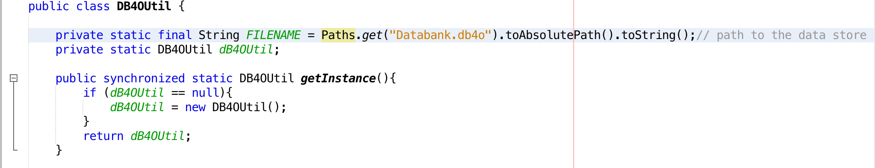
DB4O CONTINUE

Slide 13
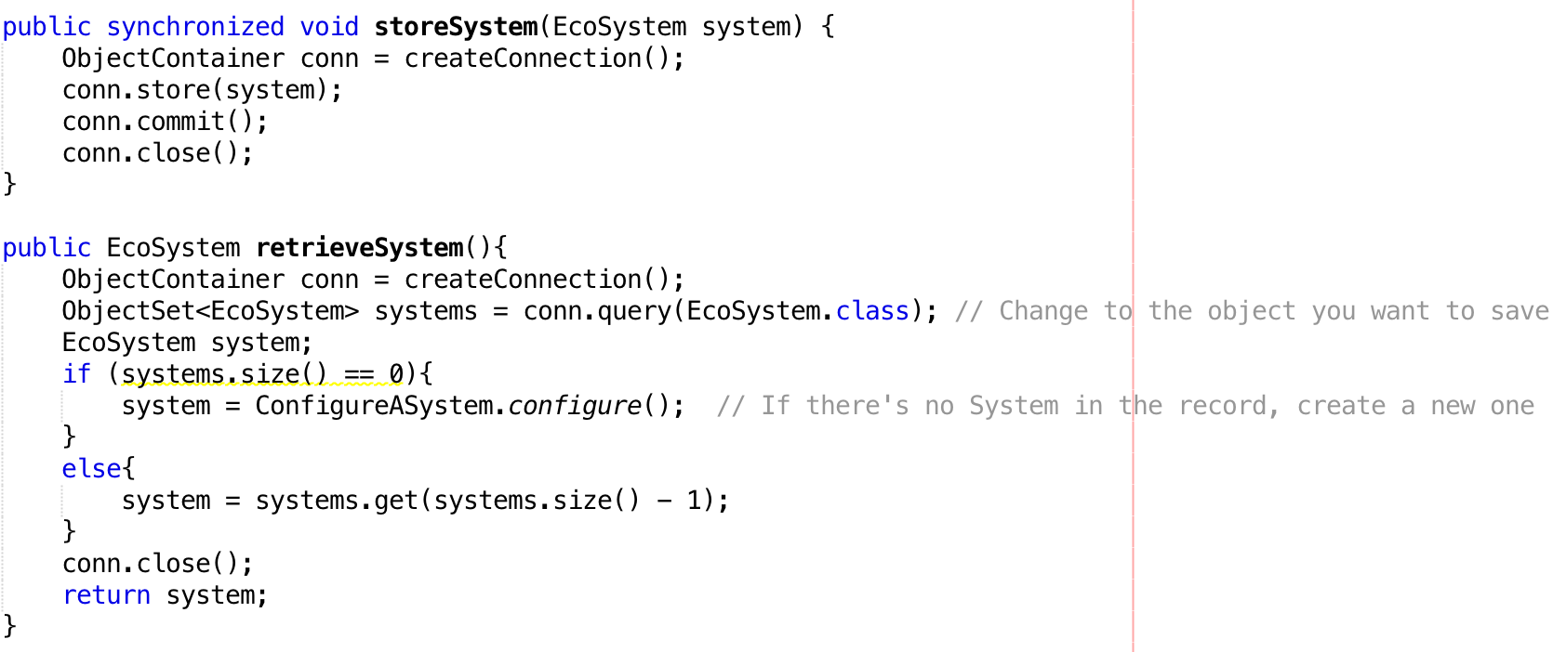
DB4O CONTINUE

Slide 14
DB4O CONTINUE
Avoid conflicts:
You can add db4o to your .gitignore file.(but don’t forget put them back when your project is done)
Or
You can change the path of your db4o file and store it outside of your project directory.

